Slide 1
IN THE NAME OF ALLAH, THE MOST BENEFICENT, THE MOST MERCIFUL
RASOOL NAWAZ SUGAR MILLS PVT LTD.,
(A Project of Gourmet Pakistan)
Paper Presentation
PSST Annual Convention 2016
Presented By
M. Tahir Javed Hashmi
M.Sc (Chemistry)
General Manager (Production)
Rasool Nawaz Sugar Mills Pvt Ltd., (A Project of Gourmet Pakistan)
Gojra Road Samundri – District: Faisalabad.
Cell: 0301-6753301
Email: tahirjavediqbal@gmail.com

Slide 2
T O P I C
Improvement in Performance of Vacuum Filters by complete isolation of Vacuum System.

Slide 3
ABSTRACT
The performance of Vacuum Filter can be improved by modifying existing common vacuum system by provision of a separate independent vacuum line and a vacuum pump to make the isolated vacuum system for both the sections of the Vacuum Filter head.
The modified isolated vacuum system improves extraction of filtrate, clarifier efficiency and exhaustion of final molasses. The system improves the quality of Sugar and recovery percentage.

Slide 4
INTRODUCTION
Our country Pakistan is blessed by Almighty Allah with huge and more than sufficient natural resources. The scientists and Engineers of sugar industry of our country are consistently endeavoring and making research to adapt and to improve the existing technologies to make sugar manufacturing process more advance and cost effective.

Slide 5
INTRODUCTION
In the same scenario, a research has been conducted at GOURMET RASOOL NAWAZ SUGAR MILLS, Samundri, Distt. Faisalabad, to improve the performance of vacuum filters by amending the existing vacuum system at vacuum filter heads. By which the sugar losses in shape of vacuum filter Pol and entrainment from vacuum filters are significantly controlled. In this paper the concentrations are focused on methods adopted, observations, results, discussions and the recommendations.

Slide 6
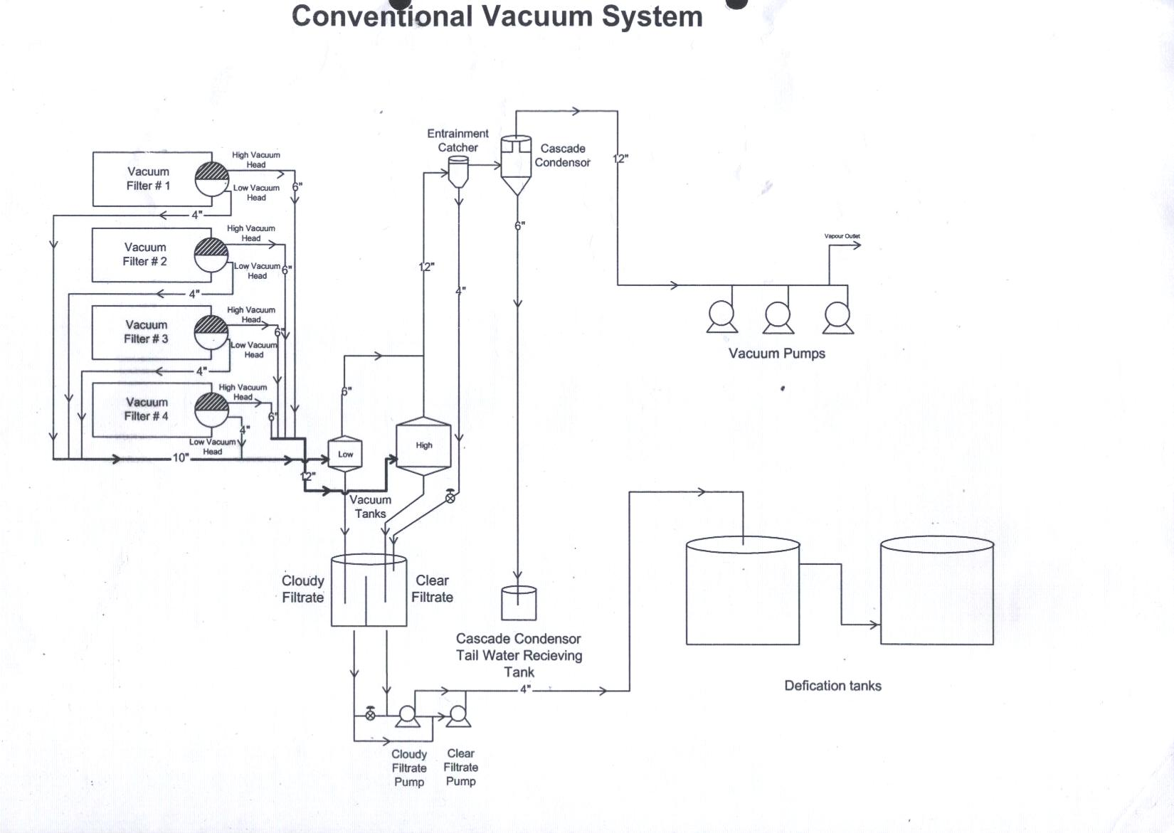
CONVENTIONAL VACUUM SYSTEM

Slide 7
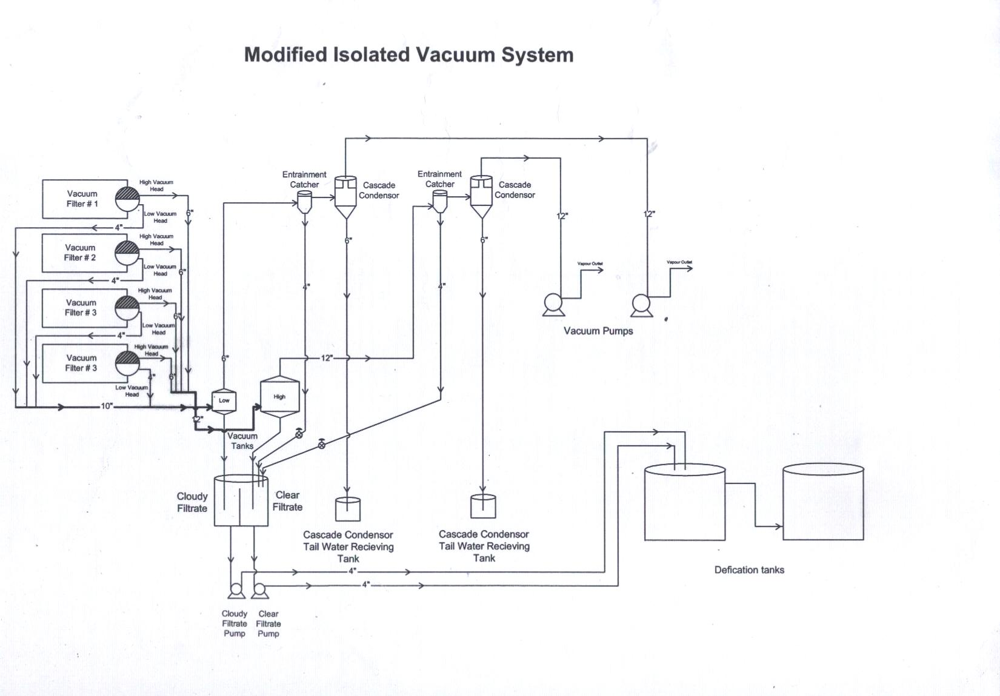
MODIFIED ISOLATED VACUUM SYSTEM

Slide 8
METHOD
The existing conventional common low and high vacuums system at vacuum filter Heads is modified and is made isolated by provision of a separate independent vacuum line for both section of head. Separate independent vacuum pumps for each section of vacuum filters head are provided. The performance of vacuum filters after modification is monitored as under.
The Vacuum at the both section of vacuum head are regularly monitored and recorded. (Annexure 1)
Filter cake samples collected from mud drum are analyzed for pol% and moisture% in laboratory hourly. (Annexure 2 & 2a)

Slide 9
METHOD
3. The spray pond water is analyzed for pH and pol% in laboratory hourly. (Annexure 3 & 3a)
4. Quantity and temperature of showering water has been monitored and recorded hourly in laboratory. (Annexure 5)
5. Performance of pan boiling is regularly monitored by the pan boiling time of each category of massecuite shift wise/Daily Basis. (Annexure 5)
6. ICUMSA of sugar produced grade wise is analyzed and recorded on daily basis in laboratory. (Annexure 5)
Note: (All the analyses are conducted according to PSST Laboratory Manual for uniform method of analysis)

Slide 10
RESULTS
Vacuum at conventional low and high sections of the head recorded are in the range of 8-10” of Hg for low section and 14-16” of Hg for high vacuum section of head.
Vacuum monitored and recorded after modification remained in range of 16-18” of Hg at both head sections.
During conventional Vacuum systems at vacuum filters, the pol% of the filter cake analyzed and recorded as average 2.8%.
After modification for vacuum system the pol% for the vacuum filter cake analyzed and recorded in laboratory as average 1.80%.
Filter cake volume during conventional vacuum system measured is in range of 8-9 lb/ft²/hr/(1/3)”.
Filter cake volume after modification of vacuum system, measured is in range of 11-12 lb/ft²/hr/(1/3)”.

Slide 11
RESULTS
7. Filter cake moisture% analyzed and recorded with conventional vacuum system in laboratory in range of 70-74%.
8. The Filter cake moisture% after modification for isolated vacuum systems is analyzed and recorded in range of 68-70%.
9. pH of Spray pond during conventional vacuum system remained inn range of 6-6.5.
10. After modification for isolated vacuum system spray pond pH remained in the range of 7.5-8.0.
11. Pol% of spray pond analyzed and recorded remained in range of 0.05-0.12.
12. The pol% of spray pond after modification for isolated vacuum system remained Nil (rare 0.01).

Slide 12
RESULTS
13. Clarity of the juices with conventional low and high vacuum system monitored and recorded is in the range of 90-92º.
14. Clarity of the juice after modification at vacuum filter heads is monitored and recorded in the range of 95-97º.
With conventional vacuum systems at vacuum filters the existing clarifiers coop up crushing rate 150-160 ton per hour maximum.
After modification of vacuum system at vacuum filters, the clarifier performance improved crushing up to 180 ton per hour.

Slide 13
RESULTS
17. Showering water temperature at vacuum filter drums monitored and recorded by laboratory hourly during conventional vacuum system remained in the range of 55-60ºC.
18. Showering water temperature with isolated vacuum system at vacuum filter drums monitored and recorded in laboratory hourly remained in the range of 55-60ºC.

Slide 14
RESULTS
19. The ICUMSA of sugar production during conventional vacuum systems at vacuum filter is analyzed and recorded in laboratory as under
R1 ICUMSA 40-45
R2 ICUMSA 50-65
R3 ICUMSA 62-70
20. The ICUMSA of sugar production after modification of vacuum systems at vacuum filter is analyzed and recorded in laboratory as under
R1 ICUMSA 35-38
R2 ICUMSA 45-60
R3 ICUMSA 55-68

Slide 15
RESULTS
21. In Conventional vacuum system, mud is disposed with use of maximum transportation. With unhygienic condition at the mud collection point.
22. In modified isolated vacuum system, mud is disposed with use of minimum transportation and with neat clean and hygienic mud collection points.

Slide 16
DISCUSSION
The improvement in performance of the vacuum filter has been achieved by modifying and making a complete isolated vacuum system for both sections of head of vacuum filters. This arrangement is made by provision of separate independent vacuum lines for each section of the vacuum filter head along with provision of separate vacuum pumps.
In the existing conventional vacuum system of the vacuum filters, the vapours collected at low and high vacuum sections of the vacuum filter head, get mixed into a common vacuum line proceeding to a common vacuum pump. In routine operation, there is regular practice of consistent breaking of vacuum at the completion of each rotation of the drum. During the start of creation of vacuum during next rotation, there is faced the fluctuation in vacuum. It affects the vacuum at high section of the head. The chances for entrainment of the extracted juice in the filtrate receivers occur repeatedly. In modified isolated vacuum system, due to consistent high vacuum on both sections of the head, there occurs no fluctuation in vacuum. Therefore the entrainment chances become nil or very rare.

Slide 17
DISCUSSION
The merits of newly modified isolated vacuum system are as under:
The control of losses at vacuum filters
Due to consistent high vacuum at both sections of the heads of vacuum filters, the extraction of entangled juices is improved. As a result Pol% filter cake is substantially reduced. (Annexure 2 & 5)
2. Reduced Chances for filtrate entrainment
Due to consistent high and isolated vacuum at both sections of head, there remain no/very negligible chances for fluctuation of vacuum. Hence the entrainment at the vacuum filters becomes nil/very rare. (Annexure 5)
Improvement in clarifier performance
Due to improved performance of the vacuum filters for extraction of mud, the performance of clarifier becomes significantly improved. There is a prominent improvement in clarity of juices at clarifiers. (Annexure 4 & 5 )

Slide 18
DISCUSSION
4. The improved filtrate extraction rate
Due to high vacuum at both sections heads of the filter the quantity of the extracted filtrate juice has increased. It enhanced the quantity of juice from filters.
5. Improved showering water consumption at vacuum filters
Due to improved performance of vacuum filters, the requirement of washing water on vacuum filters has increased. It ultimately increased the filtrate quantity and with reduction in filter cake pol. (Annexure 2 & 5)
6. Enhancement in crushing rate
Due to improved performance of the clarifiers, the crushing capacity of plant has substantially enhanced. (Annexure 5)

Slide 19
DISCUSSION
7. Exhaustion of Final Molasses
Due to maximum removal of non sugars from clarifier, the quality of exhaustion of massecuite in pans has improved with substantial reduction in boiling time and control in final molasses purity. (Annexure 5)
8. Improvement in quality of sugar
Due to maximum removal of impurities at clarifier the quality of Refine sugar is prominently improved. (Annexure 5)
9. Enhancement in Rec. %age
Due to control on losses at vacuum filters in shape of filter cake pol%, very negligible entrainment from cascade condenser, improvement in exhaustion of massecuites and control of purity of molasses has impacted rec. %age substantially. (Annexure 5)

Slide 20
DISCUSSION
The system, as experienced at GOURMET RASOOL NAWAZ SUGAR MILLS SAMUNDRI, DISTT. FAISALABAD has proved fool proof with maximum control of losses in shape of filter cake pol%, control on entrainment of the juices from vacuum filter and final molasses purities, resulted in achievement of rec. %age.
Plant performance has improved with substantial increase in crushing rate, with improvement in quality of sugar production.

Slide 21
DISCUSSION
Cost Benefit Ratio
A. Crushing days = 125
Crushing rate = 4500 TCD
Filter cake % cane = 3%
(Conventional common vacuum system)
Avg. Filter cake Pol % = 2.8%
Weight Pol filter cake = 3.78 Ton
(Modified isolated vacuum system)
Filter cake% cane = 3.50%
Avg. Filter cake Pol% = 1.80%
Weight Pol. filter cake = 2.83 Ton
Difference weight recoverable sugar = 0.95 Ton
Recovery% impact = 0.021%
Estimated recoverable sugar per season = 0.95 Ton X 125
= 118.75 Ton
= 118750 Kg
Estimated price of sugar per kg = 55 Rs
Total Price of sugar recovered per season = 6,531,250 Rs.

Slide 22
DISCUSSION
Expenditures
Vacuum Pump capacity = 2000 cfm
No. of pumps = 02
Price per pump = 500,000 Rs/pump
= (1,000,000 Rs)
M.S. Vacuum Line
Diameter = 250 mm
Length = 24 m
Price per meter = 8000 Rs.
Total Price = 192,000 Rs.
Electric Motors = 02 numbers
Capacity = 50 Amp each
Price per motor = 300,000 Rs
= (600,000 Rs)
Fittings
Vacuum gauges = 08 Numbers
Price per gauge = 2000 Rs
= (16000 Rs.)
Total Expenditure = 1,616,000 Rs.
Cost benefit Ratio = A/B
= 3.04:1

Slide 23
RECOMMENDATION
During the season 2015-2016, The GOURMET RASOOL NAWAZ SUGAR MILLS has achieved prominently excellent results in the area for production of quality of sugar and the Rec. %age.
The performance of vacuum filter can be made significantly improved by adopting the isolated vacuum systems at vacuum filters in place of conventional common vacuum system. By this system maximum vacuum at both sections is achieved with rare fluctuation in vacuum. As a result, the loss of sugar in the process is substantially controlled with prominent enhancement in recovery %age.
It is recommended that at sugar plants, isolated vacuum system should be adapted for vacuum filters in place of conventional common vacuum system.

Slide 24
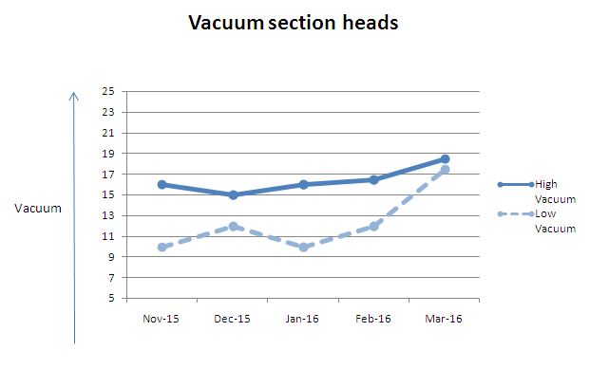
Annexure 1

Slide 25
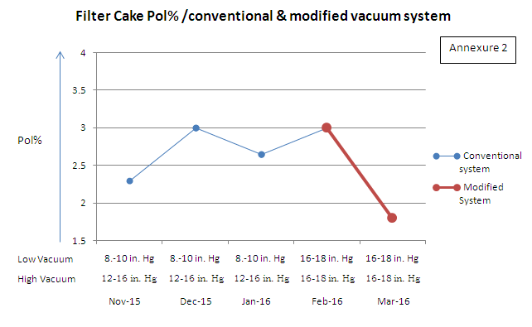
Annexure 2

Slide 26
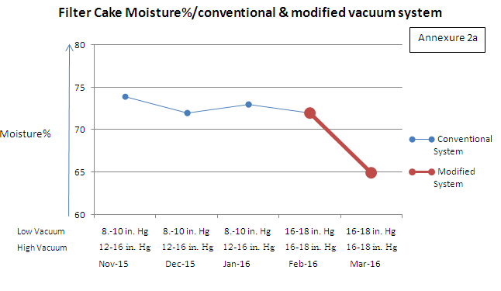
Annexure 2a

Slide 27
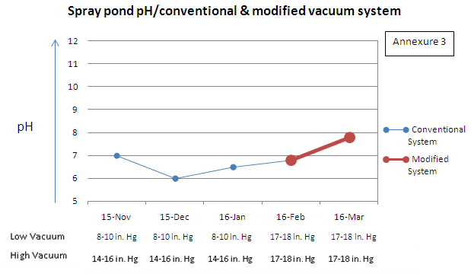
Annexure 3

Slide 28
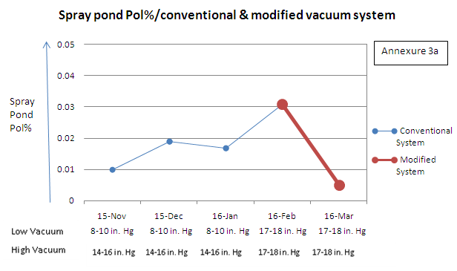
Annexure 3a

Slide 29
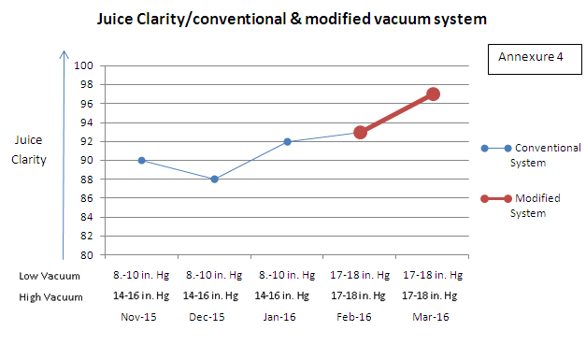
Annexure 4

Slide 30
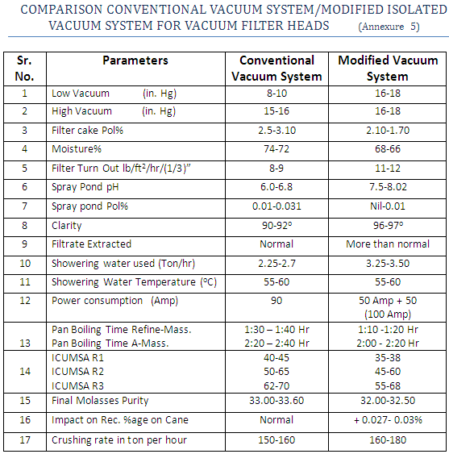
Annexure 5

Slide 31
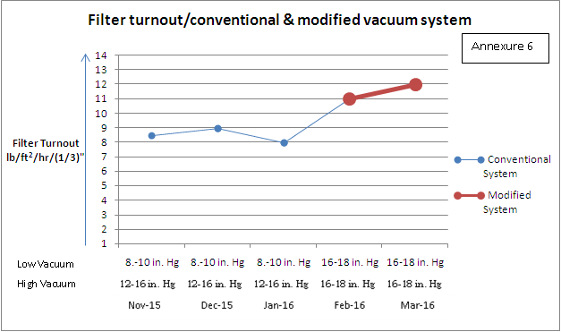
Annexure 6

Slide 32
ACKNOWLEDGEMENT
I am very thankful to the Management of GOURMET RASOOL NAWAZ SUGAR MILLS PVT. LTD. especially Mian Adnan Aslam for the approval with great pleasure to represent the technical paper on PSST forum.
I am grateful to Mr. Sajid Naqvi for his kind technical advices during the performance of the practical work.
Gratitude to Mr. Mazhar Shafiq, General Manager Gourmet Rasool Nawaz Sugar Mills, for providing technical advice and encouragement during practical work of the experiment.
I am Thankful to technical team at the Gourmet Rasool Nawaz Sugar Mills plant, especially to Mr. Ahmad Ammar Chemical Engineer and Mr. Javed PA to GM for coordination and assistance during practical work, compiling and final write up of the paper.
THANK YOU.

Slide 33
THANK YOU

